Slide 1
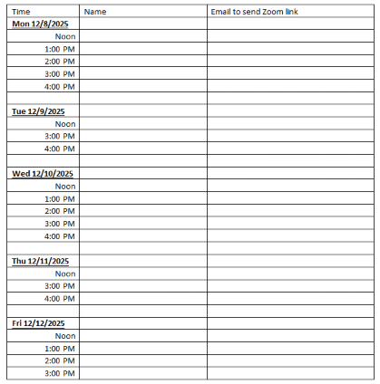
Sign up for end of semester interviews
Extra credit points added to end of semester abstracts
December 8-12, request other date/time if needed
You may do EVEN if you didn’t do the interview at the beginning of the semester.
You’ll be asked a little bit about yourself, things you liked in the class, and things you think could be improved.
I will not know who said what.

Slide 2
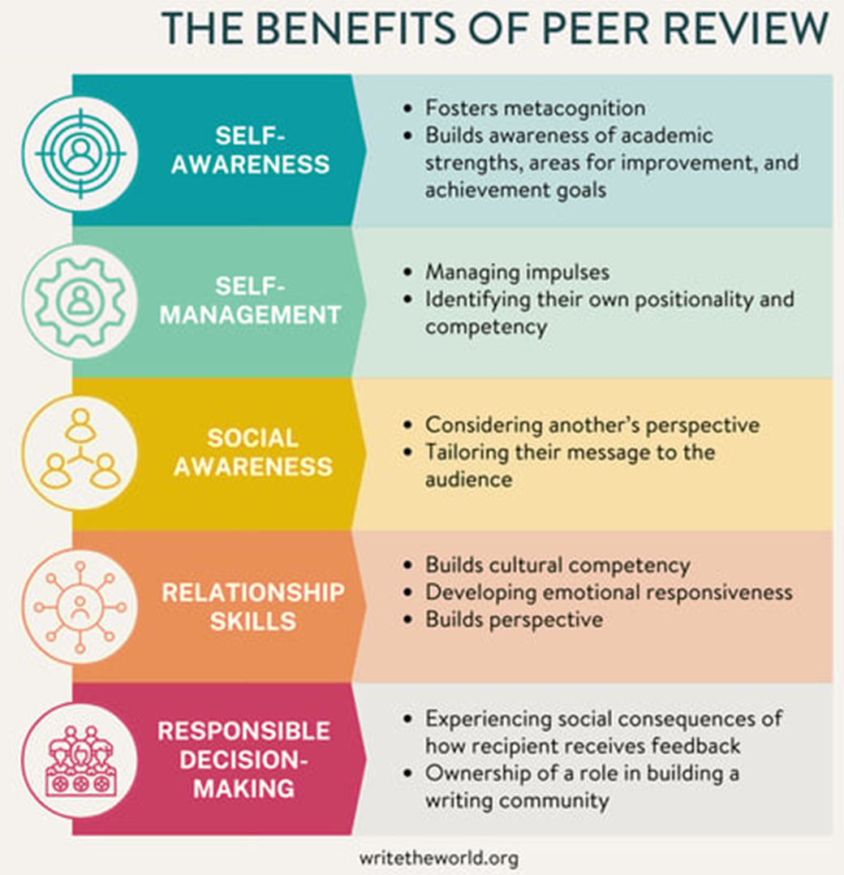
Today’s Goals
The importance of our class goals (discussed last time)
Giving peer feedback to each other on our graphs/setups
Practicing our communication
Notes:
Femi is going to finish off what he was showing on Lorentzian fitting, since we ran out of time last time.

Slide 3
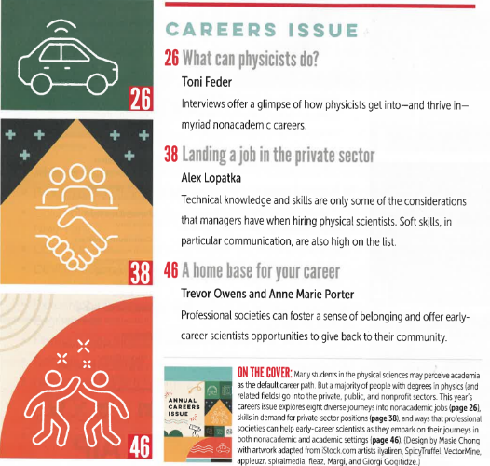

Notes:
Move some of this to MAAM1 next year

Slide 4
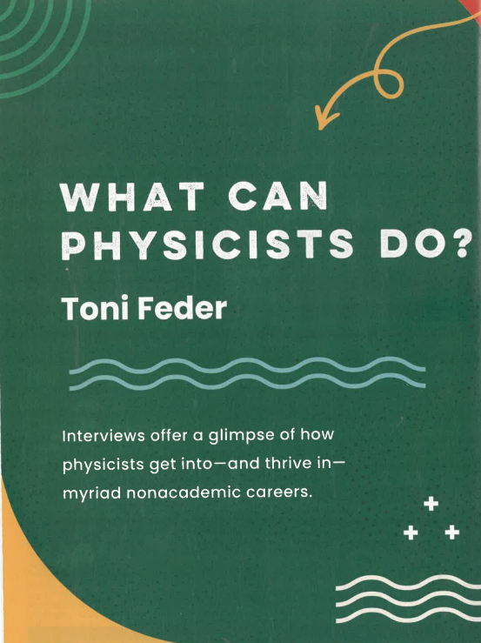
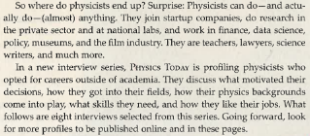
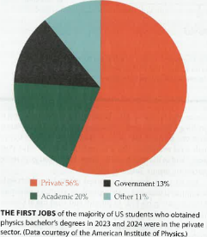
https://physicstoday.aip.org/issue/78/11
Notes:
Move some of this to MAAM1 next year

Slide 5
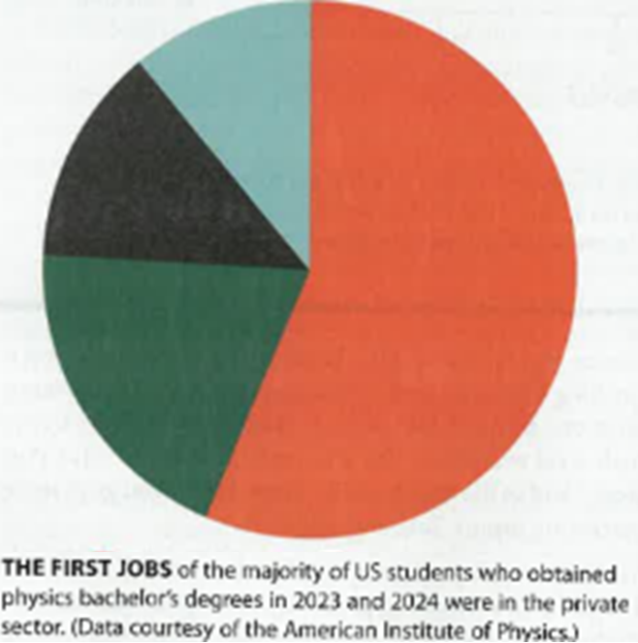
Making a Graphing Point Which is easier to understand?
Other 11%
Government 13%
Private 56%
Academic 20%
While I generally prefer to keep font sizes fairly consistent, you can break this rule of thumb if you are trying to make a point.
Notes:
Your brain has to link together the colors. It’s just extra work for the reader. This topics isn’t too hard to understand, but what about when it’s something more complicated.
You might be asking, if a magazine doesn’t always get this right, why do I have to bother? I suppose you don’t. However, if you want to become a master communicator, I can show you some tricks. ☺ Yes, I totally recognize that I don’t get it right every time. There’s only so much time in the day, and as you’ve seen, perfecting things takes time. You have to decide where best to focus your efforts. It’s not always obvious!

Slide 6
You could even do something silly and use the font size to emphasize
Other 11%
Government 13%
Private 56%
Academic 20%
Font size is used here to emphasize differences in proportion but are not exactly to scale for clarity to the reader.
Notes:
Note: the font sizes aren’t really to scale. I tried. One was either way too big or way too small. I think it’s ok to not be to scale.

Slide 7
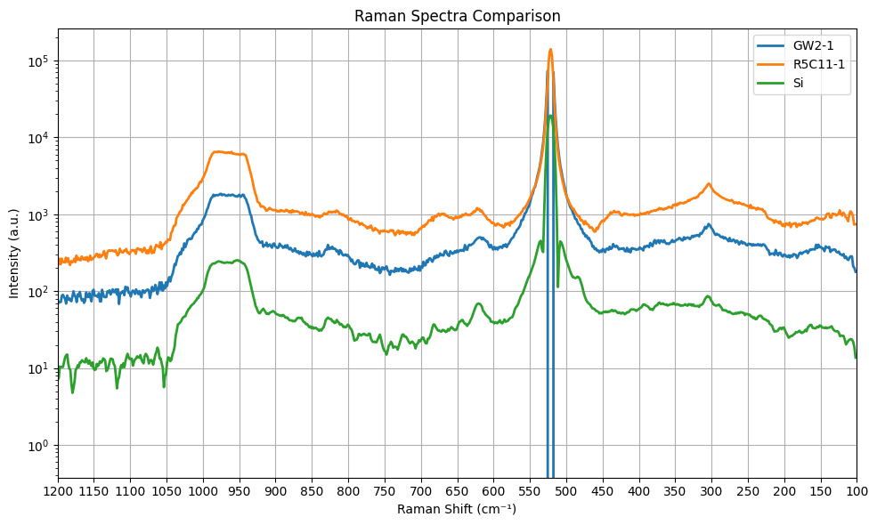
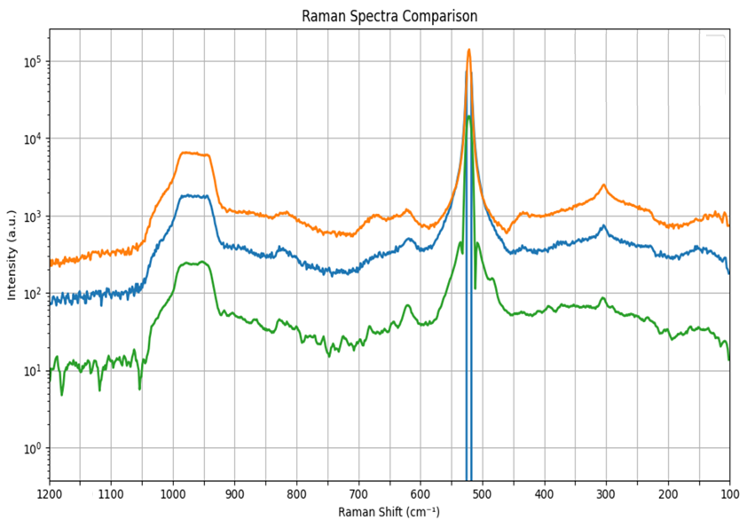
Legends similar for data
Slightly better
Fine for the lab notebook
Less oxidized device on Si
Highly oxidized device on Si
Intensity (a.u.)
Silicon substrate
Note: I remove the legend in favor of labeling each set of data near it with same color.
Raw data
Raman Shift (cm⁻¹)
To make publishable: Bigger numbers, drop gridlines, reverse x axis, subtraction of Si from data, looks like one sample saturated
Best would be to include this raw data, but then also add the subtraction. Possible have one as an inset. Which depends on if you have anything.
Notes:
I normally don’t like connecting the dots BUT when I look through the literature for Raman spectra, I do notice that seems to be common practice. Thus, I probably won’t be as
In most data, lines are supposed to mean a trend or at least a guide to the eye. Silly chemists and their having plenty of data. I joke; I love chemists. But, I can tell you a physicist definitely did not set this standard.

Slide 8

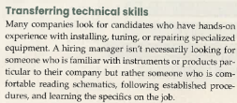
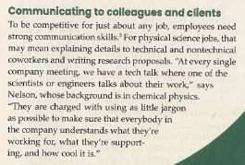
Notes:
I’m not copying the whole article but parts I thought were most important for you to hear. Feel free to go read the rest! https://physicstoday.aip.org/issue/78/11

Slide 9
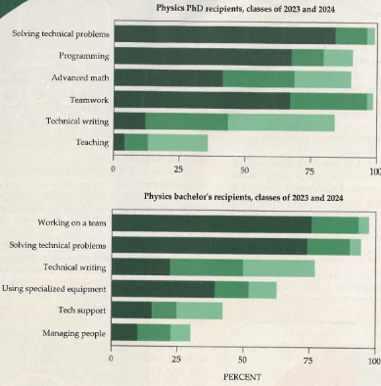

Some of the skills used by employees in the private sector
Note how much team work for both!
Also technical writing. That’s just a form of communication!
Notes:
Probably move this to earlier in the class, maybe MAAM1. Put it here because it JUST was published! https://physicstoday.aip.org/issue/78/11

Slide 10
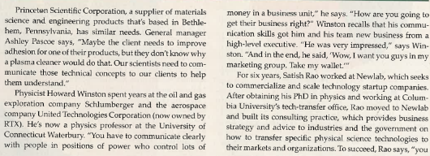
Some nice examples included

Slide 11
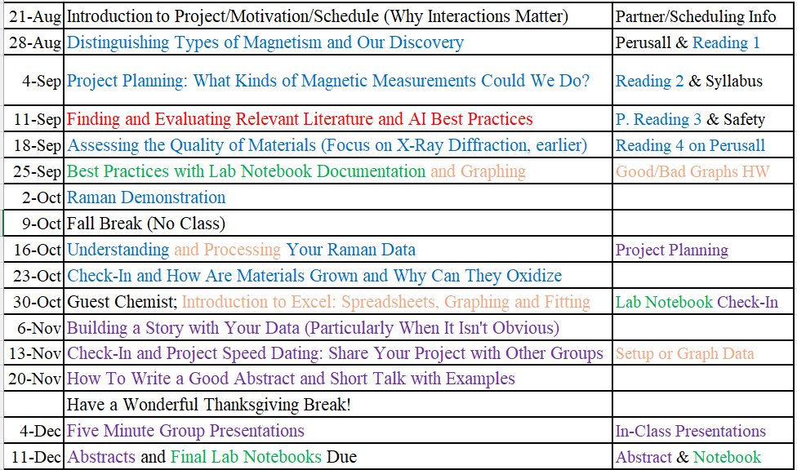
Now we focus more on communication
Printed copy please

Slide 12
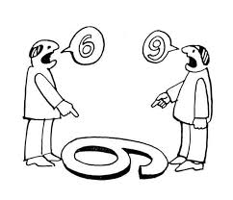
I am going to look at your graphs/setups differently than your classmates. I have assisted in helping you think about your stories, so I know what you are trying to communicate. Your peers may not. That’s a useful perspective, because the random paper reader will not know your goal as well. Thus, peer feedback is ALSO helpful, as it provides a different perspective. An unbiased opinion is helpful! Part of why working with undergrads is useful.
Notes:
Undergrads tend to ask more basic questions and sometimes that’s super helpful to putting things into perspective!

Slide 13
Examples of what kinds of guidance you might give
Slightly better
Fine for the lab notebook
To make publishable:
Bigger numbers,
drop gridlines,
reverse x axis, subtraction of Si from data,
one sample saturated
Subtract Si from data
Highlight regions of interest! (Easiest on subtracted result)
Less oxidized device on Si
Highly oxidized device on Si
Intensity (a.u.)
Silicon substrate
Raw data
Raman Shift (cm⁻¹)
Notes:
I normally don’t like connecting the dots BUT when I look through the literature for Raman spectra, I do notice that seems to be common practice. Thus, I probably won’t be as
In most data, lines are supposed to mean a trend or at least a guide to the eye. Silly chemists and their having plenty of data. I joke; I love chemists. But, I can tell you a physicist definitely did not set this standard.

Slide 14
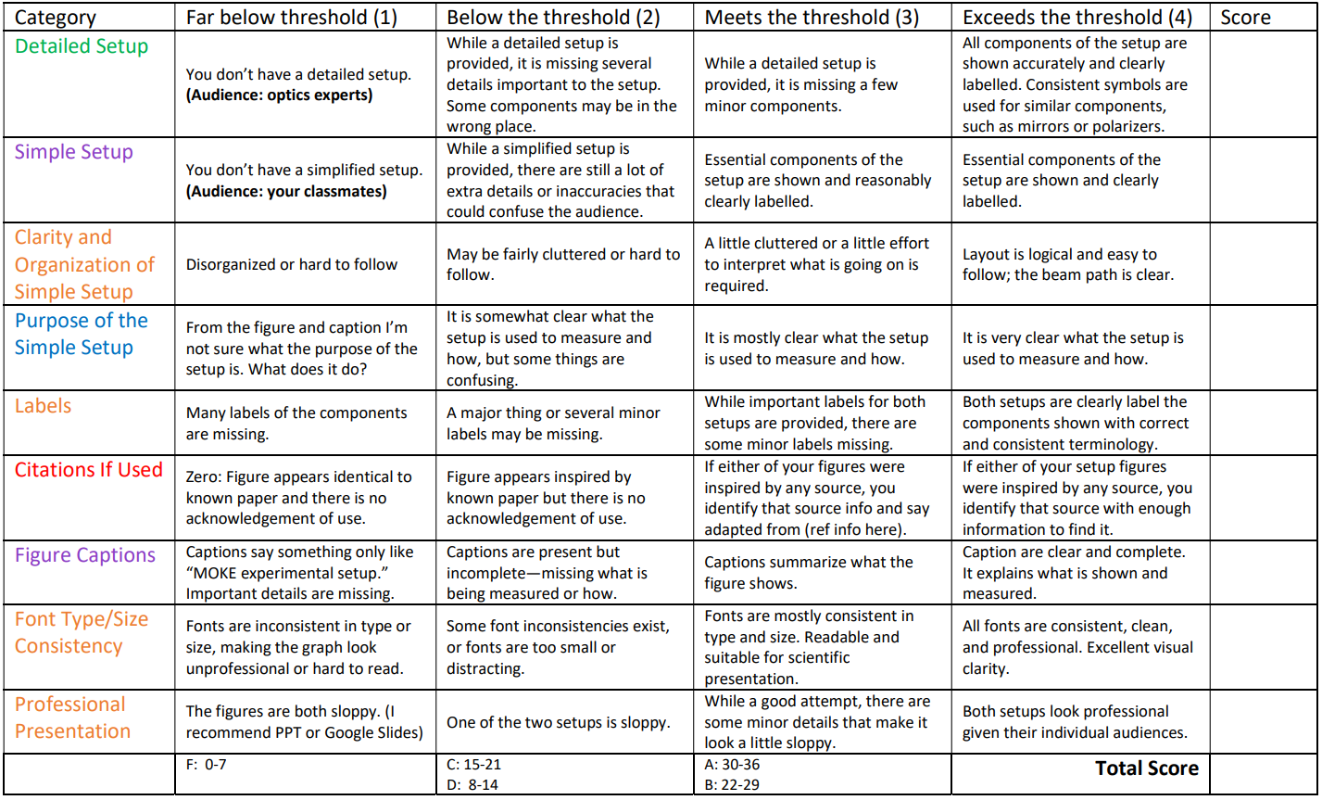
Practice in getting a figure ready for a paper No, we don’t put this much effort in for every figure in our notebooks, but we do for paper figures.
Important for notebooks
As in a paper
Notes:
Example: irises. Do you think they belong in the simple?

Slide 15
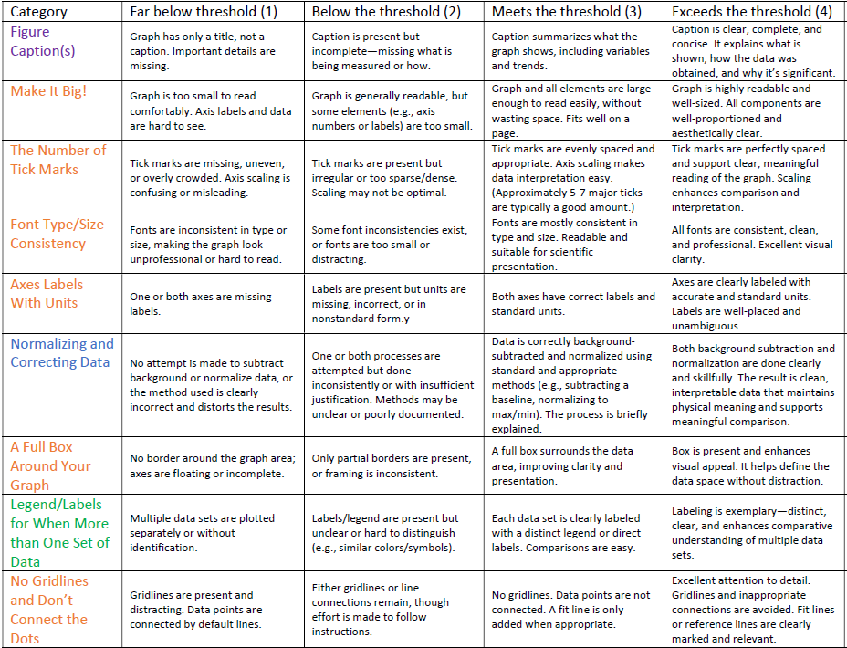

Slide 16
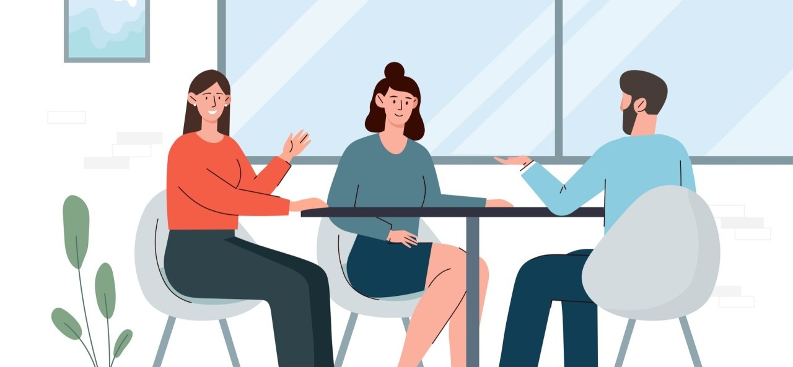
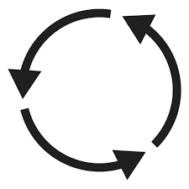
To practice: Switch figures with your partner(s)
Spend a few minutes looking.
Discuss what you like from their figures and what ideas you have that could improve it.
Is their finding/setup purpose clear?
Do not write feedback on the graphs; use separate paper. I still need to grade them.
If someone doesn’t have theirs, have the person sketch out their plans and give feedback
The goal here is not to evaluate but to improve.
Notes:
Graphs/setups

Slide 17
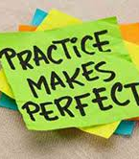
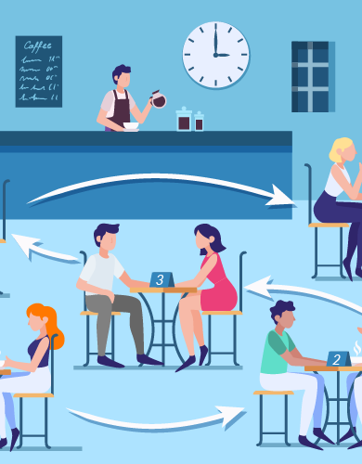
Now match up with 1 person NOT in your group. Let me know if you need help.
Listener: Be ready with questions you have.
Why should I care?
What did you do?
What do you expect to find?
What have you found so far?
What are the next steps?
Why are these steps and/or findings important?
Notes:
Think of this like speed dating except that you are getting practice in talking about your research.
Minimum: 30 minutes
I want to do this at least 3 times. I expect each person to take probably not longer than 5 minutes, so each pair could take ~10 minutes. Give reminder at 5 minutes to wrap up and switch to other person.

Slide 18
Would you like to work to improve this class?
I do have some funds to improve the class. So if this semester or next year, you’d like to spend some time working on any of the class materials to make anything more clear, please come talk to me. (Minimum wage and we have to set up the paperwork.)
You don’t have to have done well in the class to do this. One that struggled in the class might have the best ideas on how to make it better!
Notes:
Maybe move?

Slide 19
Submit your graphs/setups at the end of class

